Slide 1
Chapter 2 – Design and Implementation
Software Architecture and Design
Mutah University
Faculty of IT
Department of Software Engineering
Dr. Ra’Fat A. AL-Msie’Deen
rafatalmsiedeen@mutah.edu.jo
https://rafat66.github.io/Al-Msie-Deen/

Slide 2
Assignment
Draw diagrams showing a conceptual view and a process view of the architecture of the Interactive Multimedia Magazine for IT News application (IMMITN).

Slide 3
References
Textbook
Title | Documenting Software Architectures: Views and Beyond
Author(s) | Paul Clements et al.
Publisher | Addison- Wesley
Year | 2010
Edition | 2nd Edition
Book Website
References | TBA in the class – refer to the website Ian Sommerville. Software Engineering (l0th Edition). Addison Wesley, 2015, ISBN-10: 0137035152.

Slide 4
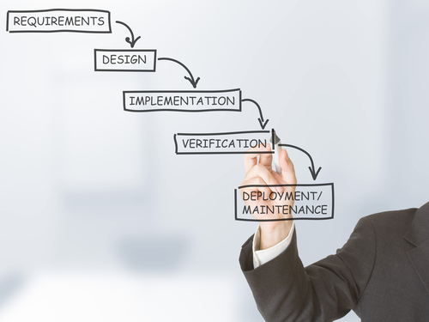

Slide 5
Objectives
The objectives of this chapter are to introduce object-oriented software design using the UML and highlight important implementation concerns.
When you have read this chapter, you will:
understand the most important activities in a general, object-oriented design process;
understand some of the different models that may be used to document an object-oriented design;
know about the idea of design patterns and how these are a way of reusing design knowledge and experience;
have been introduced to key issues that have to be considered when implementing software, including software reuse and open-source development.

Slide 6
Contents or Topics covered
Object-oriented design using the UML
Design patterns
Implementation issues
Open source development

Slide 7
Design and implementation
Software design and implementation is the stage in the software engineering process at which an executable software system is developed.
For some simple systems, software engineering means software design and implementation and all other software engineering activities are merged with this process.
However, for large systems, software design and implementation is only one of a number of software engineering processes (requirements engineering, verification and validation, etc.).

Slide 8
Design and implementation … cont.
Software design and implementation activities are invariably interleaved.
Software design is a creative activity in which you identify software components and their relationships, based on a customer’s requirements.
Implementation is the process of realizing the design as a program.
Sometimes there is a separate design stage, and this design is modeled and documented.

Slide 9
Design and implementation … cont.
At other times, a design is in the programmer’s head or roughly sketched on a whiteboard or sheets of paper.
Design is about how to solve a problem, so there is always a design process.
However, it isn’t always necessary or appropriate to describe the design in detail using the UML or other design description language.

Slide 10
Design and implementation … cont.
Design and implementation are closely linked, and you should normally take implementation issues into account when developing a design.
For example, using the UML to document a design may be the right thing to do if you are programming in an object-oriented language such as Java or C#.
It is less useful, I think, if you are developing using a dynamically typed language like Python.
There is no point in using the UML if you are implementing your system by configuring an off-the-shelf package.
As I discussed in SE, agile methods usually work from informal sketches of the design and leave design decisions to programmers.

Slide 11
Design and implementation … cont.
One of the most important implementation decisions that has to be made at an early stage of a software project is whether to build or to buy the application software.
For many types of application, it is now possible to buy off-the-shelf application systems that can be adapted and tailored to the users’ requirements.
For example, if you want to implement a medical records system, you can buy a package that is already used in hospitals.
It is usually cheaper and faster to use this approach rather than developing a new system in a conventional programming language.

Slide 12
Design and implementation … cont.
When you develop an application system by reusing an off-the-shelf product, the design process focuses on how to configure the system product to meet the application requirements.
You don’t develop design models of the system, such as models of the system objects and their interactions.
The reuse-based approach to development.

Slide 13
Design and implementation … cont.
I assume that most students of this course have had experience of program design and implementation.
This is something that you acquire as you learn to program and master the elements of a programming language like Java or Python.
You will have probably learned about good programming practice in the programming languages that you have studied, as well as how to debug programs that you have developed.
Therefore, I don’t cover programming topics here.

Slide 14
Design and implementation … cont.
This chapter has two aims:
To show how system modeling and architectural design (covered in Chapters 1) are put into practice in developing an object-oriented software design.
To introduce important implementation issues that are not usually covered in programming books. These include software reuse, configuration management and open-source development.

Slide 15
Design and implementation … cont.
As there are a vast number of different development platforms, the chapter is not biased toward any particular programming language or implementation technology.
Therefore, I have presented all examples using the UML rather than a programming language such as Java or Python.

Slide 16
Design and implementation … cont.
Software design and implementation is the stage in the software engineering process at which an executable software system is developed.
Software design and implementation activities are invariably inter-leaved.
Software design is a creative activity in which you identify software components and their relationships, based on a customer’s requirements.
Implementation is the process of realizing the design as a program.

Slide 17
Build or buy
In a wide range of domains, it is now possible to buy off-the-shelf systems (COTS) that can be adapted and tailored to the users’ requirements.
For example, if you want to implement a medical records system, you can buy a package that is already used in hospitals. It can be cheaper and faster to use this approach rather than developing a system in a conventional programming language.
When you develop an application in this way, the design process becomes concerned with how to use the configuration features of that system to deliver the system requirements.

Slide 18
Object-oriented design using the UML

Slide 19
Chapter 2 – Design and Implementation
Software Architecture and Design
Mutah University
Faculty of IT
Department of Software Engineering
Dr. Ra’Fat A. AL-Msie’Deen
rafatalmsiedeen@mutah.edu.jo
https://rafat66.github.io/Al-Msie-Deen/

